Slide 1
My MHD code
Justin Angus

Slide 2
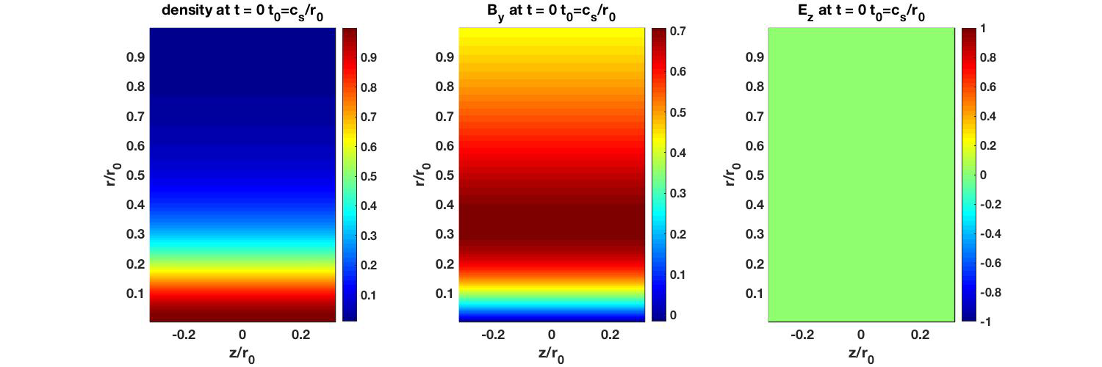
Hall MHD (JxB and gradP) (Li/r0=5.0e-3)

Slide 3
Hall MHD (JxB and gradP) (Li/r0=1.0e-1)

Slide 4
Drift-Ideal MHD model

Slide 5

Sausage mode can be stabilized with increasing adiabatic coefficient Ideal MHD with Bennett profiles
γ=5/3
γ=2.1

Slide 6
unstable sausage mode drifts with electrons in drift-ideal model (Hall effect)
Ideal MHD γ=5/3
drift-ideal γ =5/3 L_{i}/r₀=5.0e-3

Slide 7
Increasing gamma stabilizes m=0 in ideal MHD Increasing gamma in drift-ideal stabilizes ideal mode, but destabilizes entropy mode
Ideal MHD γ=2.1
drift-ideal γ =2.1 L_{i}/r₀=5.0e-3

Slide 8
Entropy mode can be stabilized with strong thermalization such that Te≈Ti
drift-ideal γ =2.1 L_{i}/r₀=5.0e-3
NuT= 100
drift-ideal γ =2.1 L_{i}/r₀=5.0e-3
NuT = 0

Slide 9
Entropy mode grows slower than ideal mode
Increasing gamma larger than 2 stabilizes ideal mode, but destabilizes entropy mode
Entropy mode can be stabilized by driving electron and ion temperatures to be the same
Thermalization has no significant affect on ideal mode
Seeded mode: kR=10, krhoi = 0.1

Slide 10
Axial field is predominately electrostatic
t=20 t₀

Slide 11
Electrostatic potential obtained from Helmholtz decomposition

Slide 12
Helmholtz decomposition decomposes vector field into solenoidal and irrotational components

Slide 13
Helmholtz decomposition for electric field assumes Coulomb gauge:
Potential field phi is equivalent to scaler potential that satisfies the Poisson equation and is directly related to charge density when using Coulomb gauge

Slide 14
Electric field is predominately electrostatic
static
inductive
total
z-electric field
r-electric field

Slide 15
Potential values

Slide 16
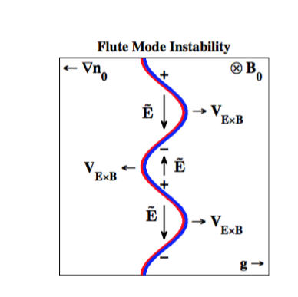
Very similar to electrostatic flute modes
Density variation normal to direction of magnetic field and curvature and gradient drifts causes polarization and resulting electrostatic fields, which then drive plasma with ExB drift

Slide 17
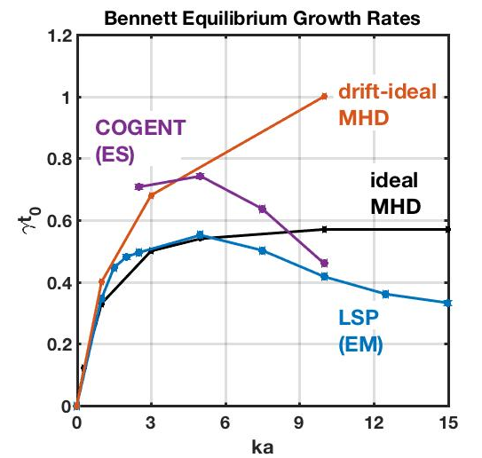
Comparing m=0 growth rates from different models for Bennett Equilibrium
FUZE parameters
N0 = 4.25e24/m3
T0 = 1270 eV
a = 9.1e-4 m
Mi = 1.6605e-27 kg (hydrogen)
t0 = a/Cs=a/sqt(2T0/Mi)
Li/a = c/wpi/a = 0.12

